Slide 1

Introduction
Photodynamic Therapy Delivery System
MEMBERS:
Michael Bernatzky, Cobi Ben-David, Ryan Donovan, Simon Ioffe, Andrew Zamsky
ADVISOR:
Professor B.K. Jaeger
CONSULTANT:
Professor A. Gouldstone
Notes:
Say what the team is commissioned with right away

Slide 2
Why Does This Matter?
Scope
Treatment
Definition
Skin Cancer
13 million Americans
Jaundice
15 million Americans
Acne
US Population
312 million
40 - 50 million Americans
Actinic Keratosis
Up to 58 million Americans

Slide 3
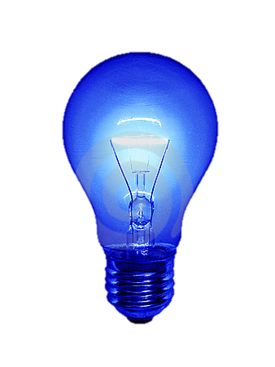
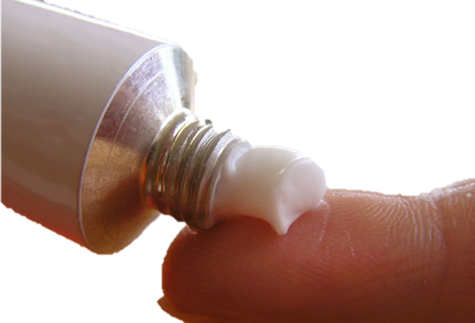
What can be done?
Why Does This Matter?
Scope
Treatment
Definition
Photodynamic Therapy
Skin Cancer
13 million Americans
Jaundice
15 million Americans
Acne
US Population
312 million
40 - 50 million Americans
Actinic Keratosis
Photosensitizing Agent (PSA)
Blue Light Delivery
Treatment of
Dermatological
Conditions
Up to 58 million Americans

Slide 4
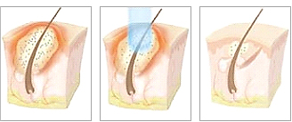
What is PDT?
Scope
Treatment
Definition
Photodynamic Therapy
PDT is a form of light-activated treatment, which works in conjunction with a photo-sensitizing agent (PSA) to target and destroy unhealthy or dangerous cells.
Activated Pharmaceutical
O₂
Oxidizing Species
(Singlet Oxygen)
Oxidative Injury to Cells
Photon
Pharmaceutical
Cellular Death
P. Acnes
PDT
P. Acnes Absent

Slide 5
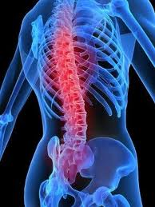

Current State
Problem Statement
Existing Devices
The Problem
For Clinicians:
Current devices are difficult to lift, adjust and operate
Existing devices are expensive which hinders their availability

Slide 6
Current State
Problem Statement
Existing Devices
The Problem
For Patients:
Current devices are hard to adjust to different parts of the body and various
body types
Treatments are often uncomfortable, dampening a patients desire to return
for treatment

Slide 7
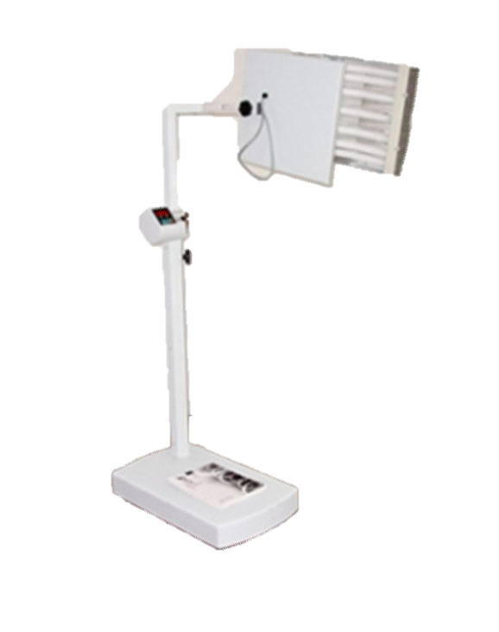

Current State
Problem Statement
Existing Devices
DUSA®
Design Goals
Flexibility | ✗
User Interface | ✗
Ergonomic | ✗
Cost | !
Patient Comfort | ✗
Poor
!
✓
✗
Adequate
Excellent

Slide 8

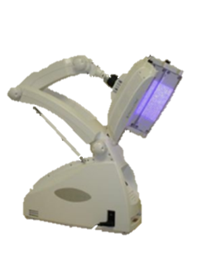
Current State
Problem Statement
Existing Devices
Design Goals
Flexibility | ✗ | !
User Interface | ✗ | ✗
Ergonomic | ✗ | !
Cost | ! | ✗
Patient Comfort | ✗ | !
Omnilux®
Poor
!
✓
✗
Adequate
Excellent

Slide 9
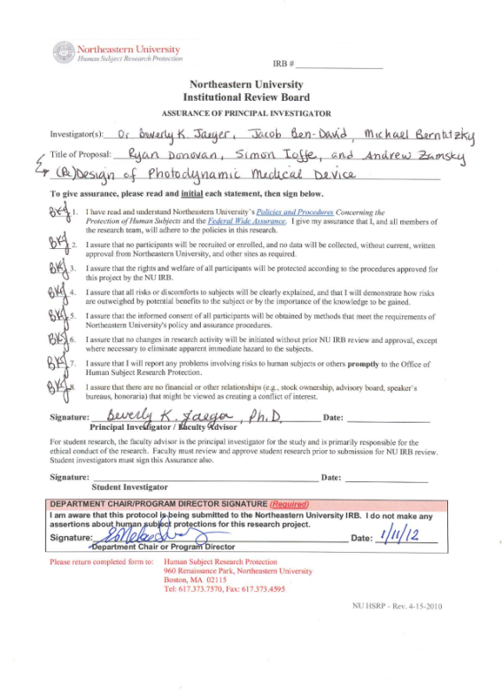

Research
Preparation
Literature
Patents
Consultations
The team has submitted an Institutional Review Board (IRB) application and received approval
All team members have successfully been certified by the National Institute of Health (NIH)

Slide 10
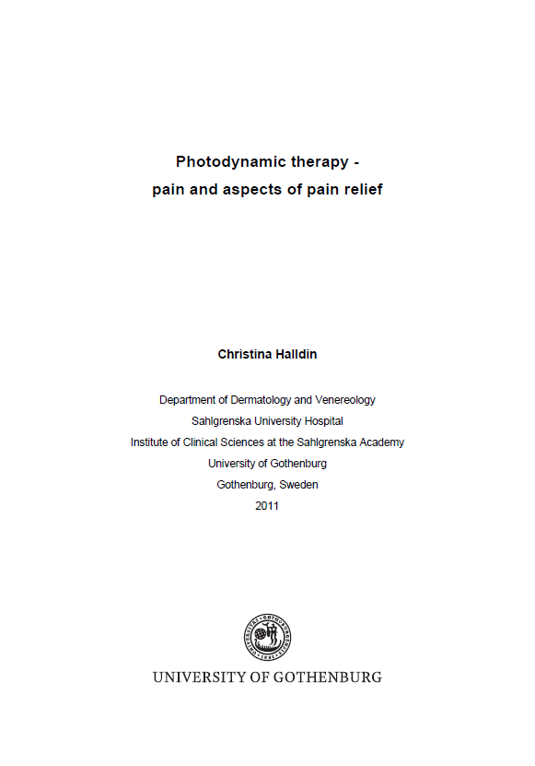
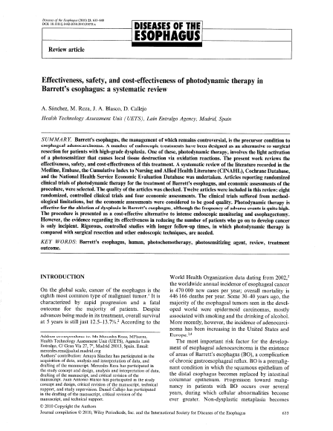
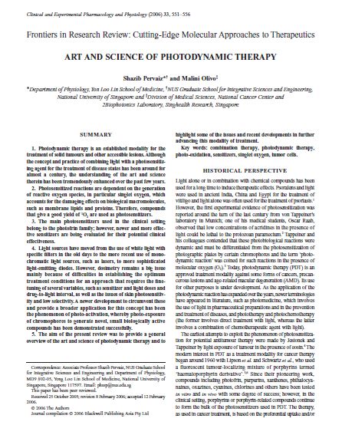
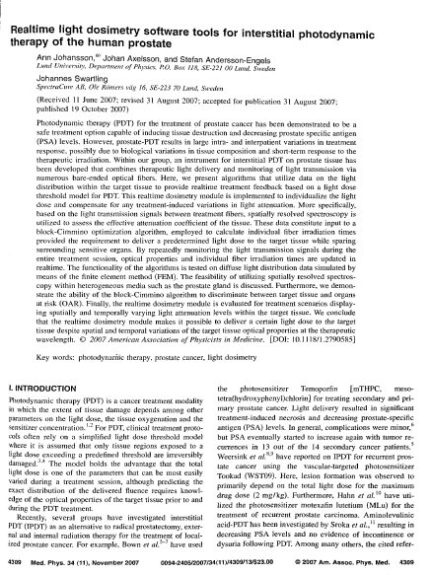
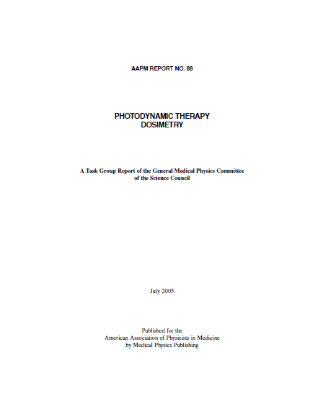
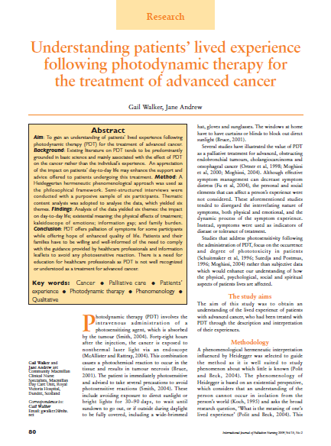
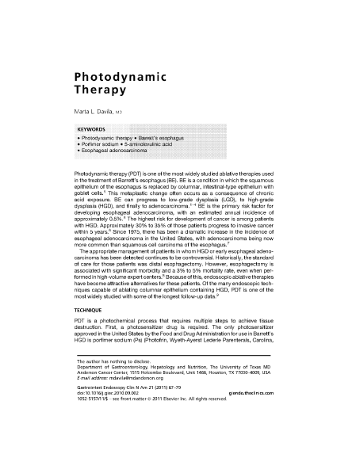
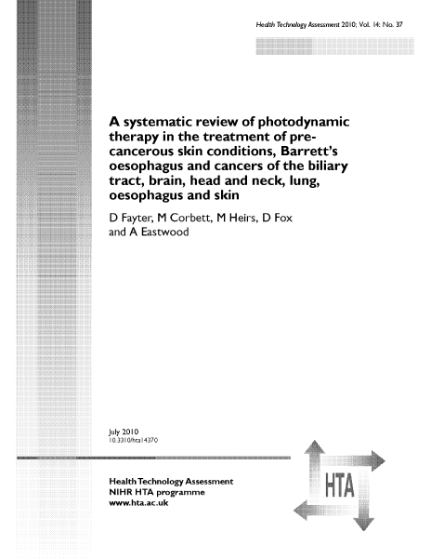
Research
Preparation
Literature
Patents
Consultations

Slide 11
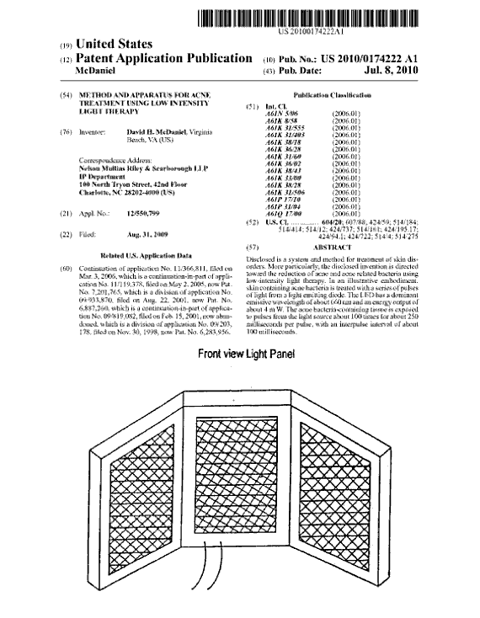
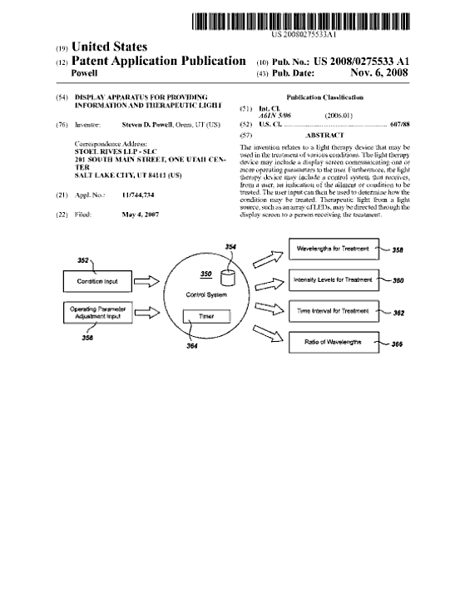
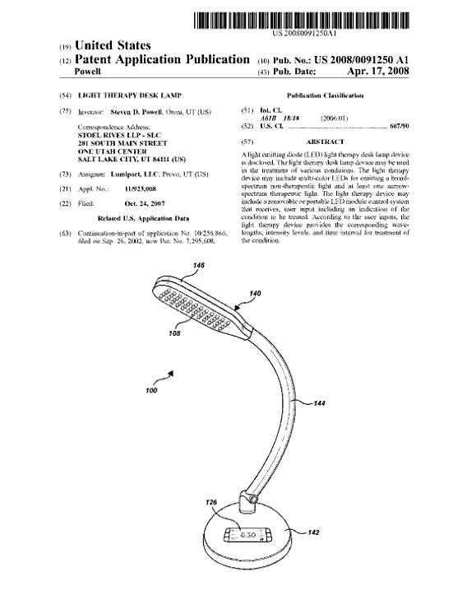
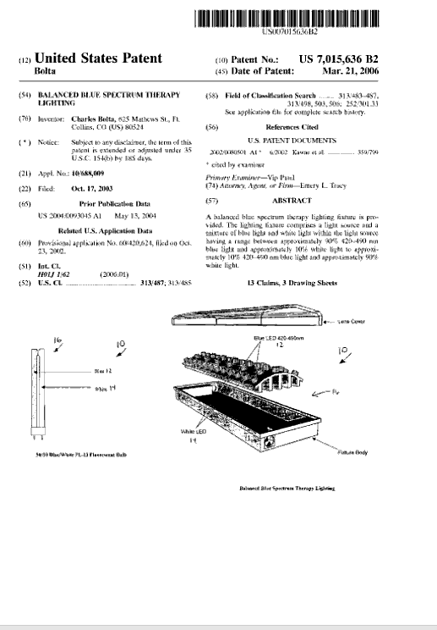
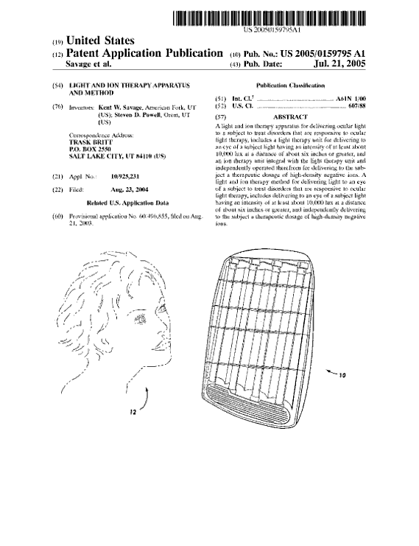
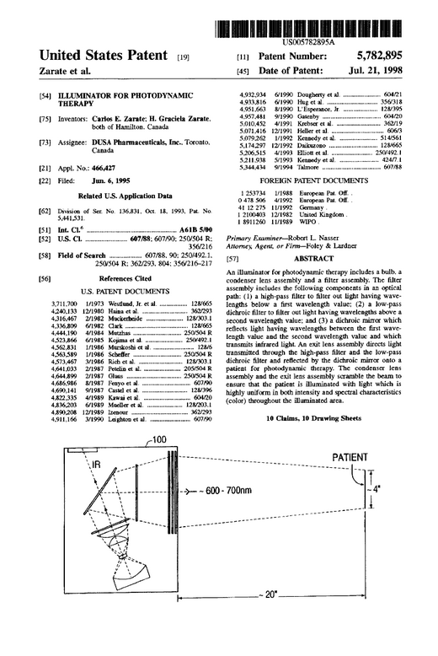
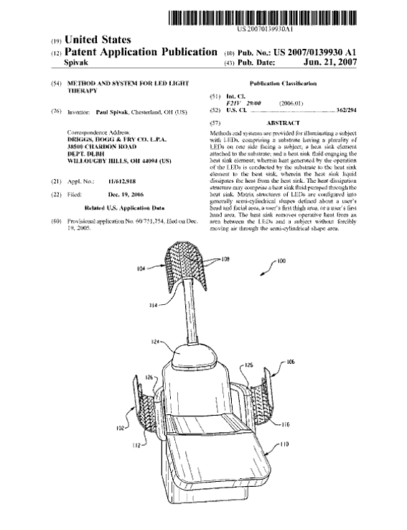
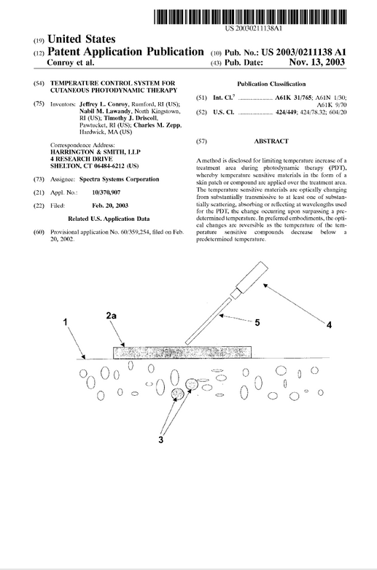
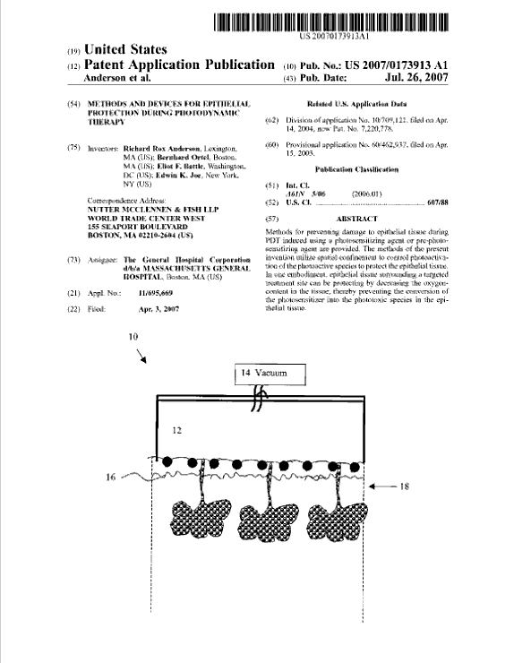
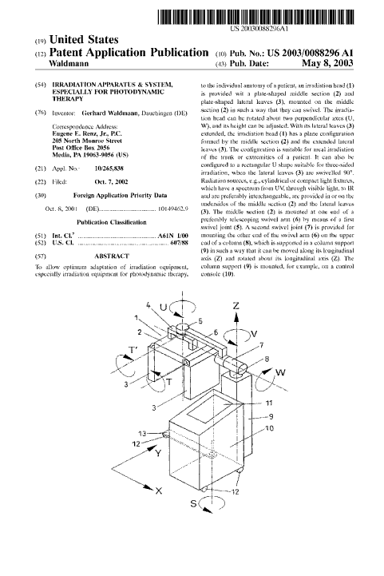
Research
Preparation
Literature
Patents
Consultations

Slide 12
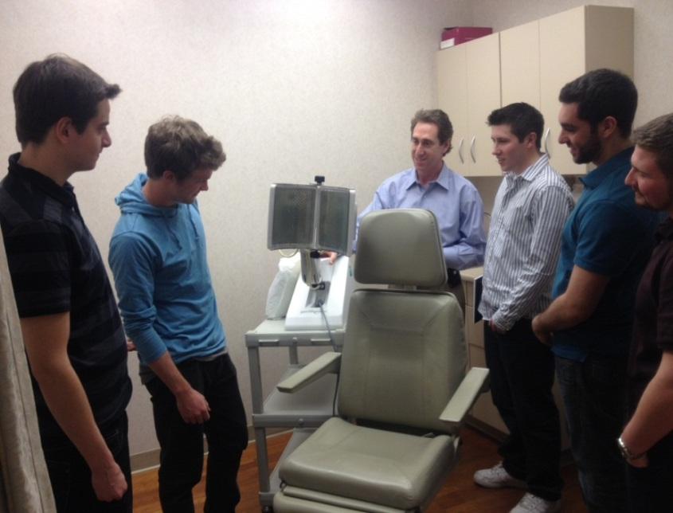


Research
Preparation
Literature
Patents
Consultations
M. Kaminer, MD
K. Nolan, RN, MSN
C. DiMarzio, PhD
Skincare Physicians
Dermatology Associates
Northeastern University Optics Lab

Slide 13

Design Process
Design Criteria
Responsibilities
Initial Concepts
Decision
Ease of use for clinicians
Flexible design for various treatment applications
Optimal patient comfort
Inexpensive cost to broaden accessibility

Slide 14
Design Process
Design Criteria
Responsibilities
Initial Concepts
Decision
Usability
Anthropometry
Ergonomics
Device Interface
Functionality
Material Selection
Cost Effectiveness
Patient Comfort
Modularity
Packaging
Flexible Optics
Adjustability
Industrial Engineering
Mechanical Engineering

Slide 15
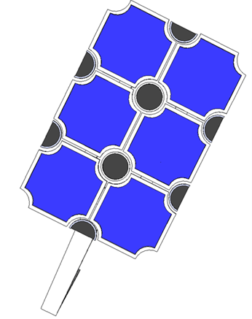
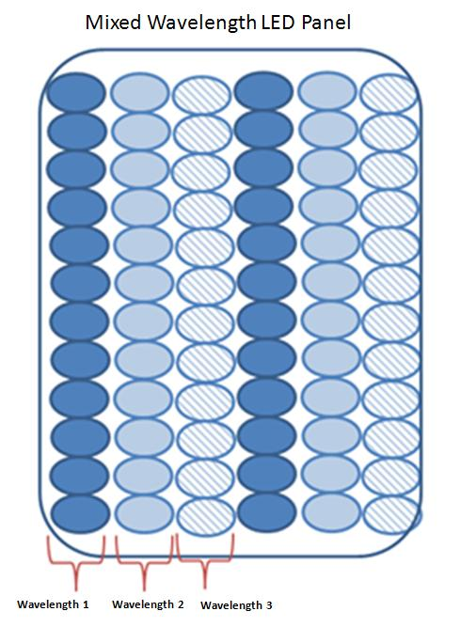
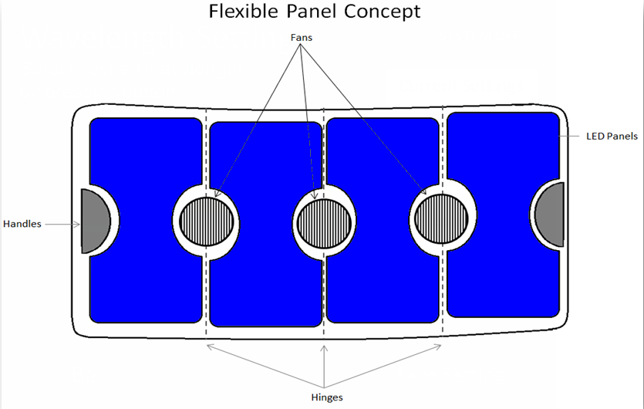
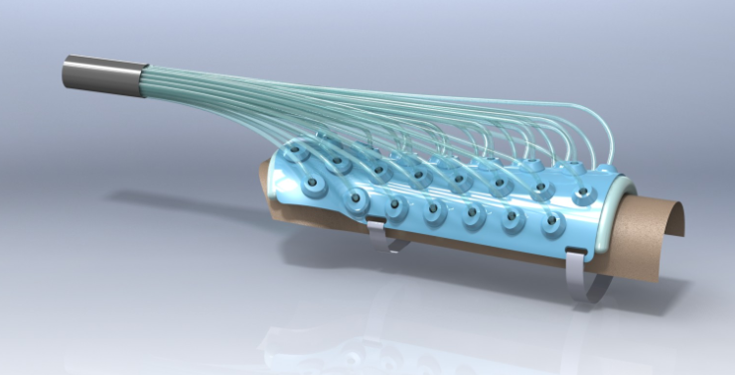
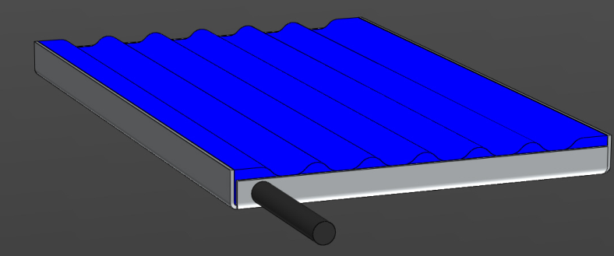
Design Process
Design Criteria
Responsibilities
Initial Concepts
Decision

Slide 16
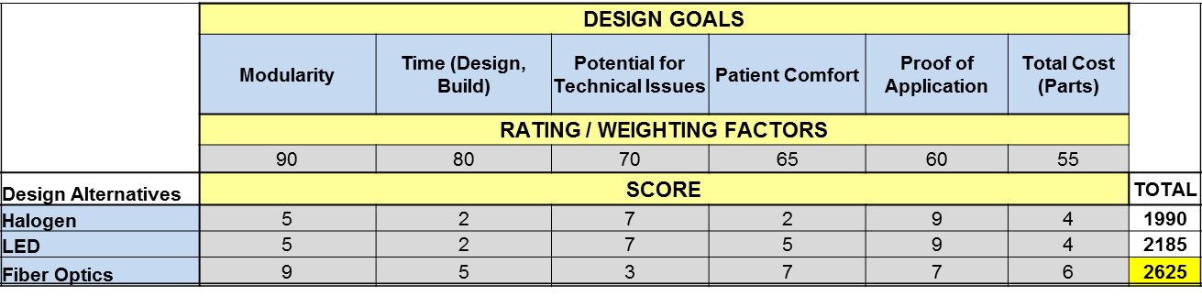
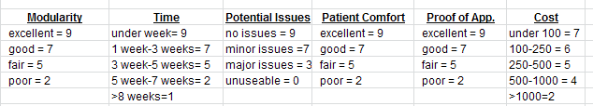
Design Process
Design Criteria
Responsibilities
Initial Concepts
Decision
Decision Matrix:

Slide 17
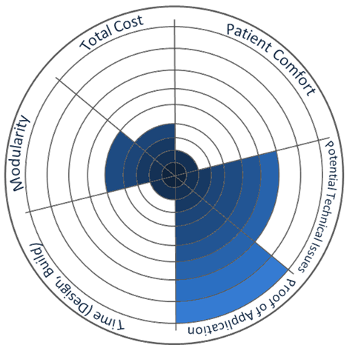
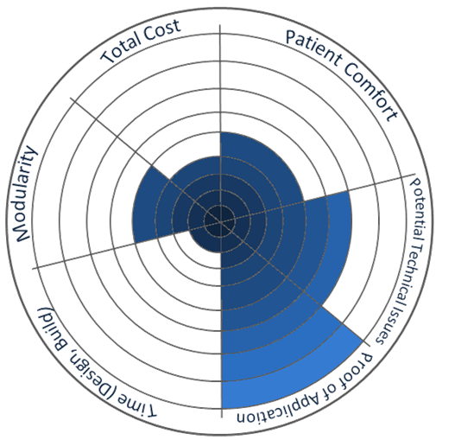
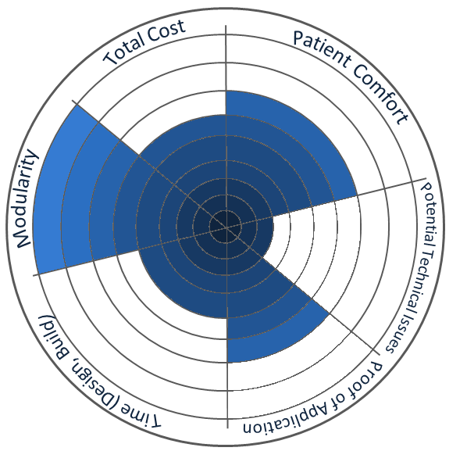
Design Process
Design Criteria
Responsibilities
Initial Concepts
Decision
Decision Matrix:
Halogen
LED
Fiber Optics
Total Score: 1900
Total Score: 2185
Total Score: 2625

Slide 18

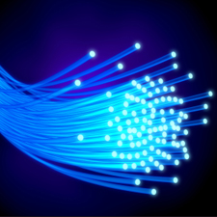
Design Analysis
Overview
MedLi_{Tx}
Wavelength Selection
Treatment Area
Concept Overview:
Heat
Light
Light
Light
Electricity
Light Source
Fiber Optic Cables
Flexible Light Mat
Patient

Slide 19

Design Analysis
Overview
MedLi_{Tx}
Wavelength Selection
Treatment Area
Notes:
Say what the team is commissioned with right away

Slide 20
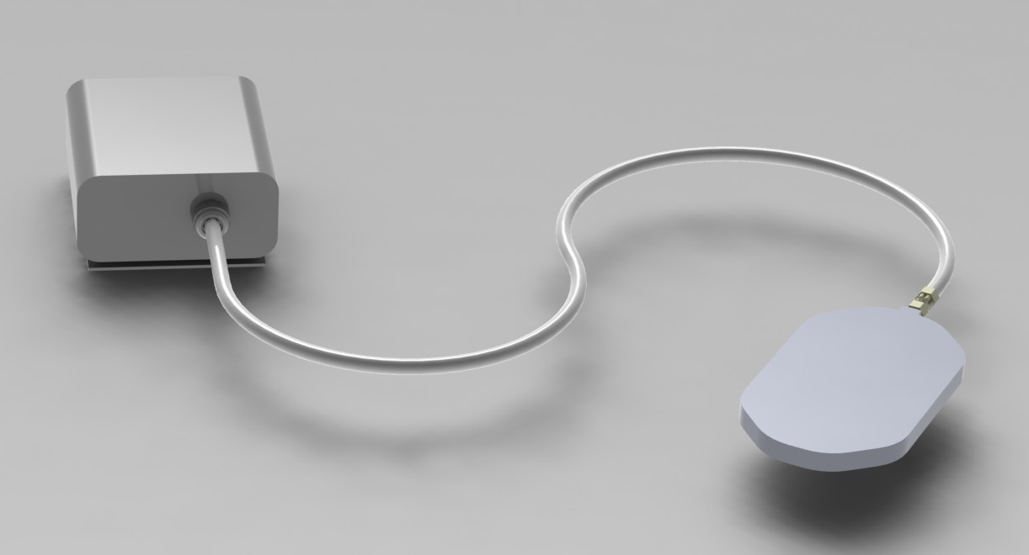

Design Analysis
Overview
MedLi_{Tx}
Wavelength Selection
Treatment Area
Flexible Fiber Optic Transmission Cable
Modular Cable Coupling
Light Source
Flexible Silicone Light Mat

Slide 21
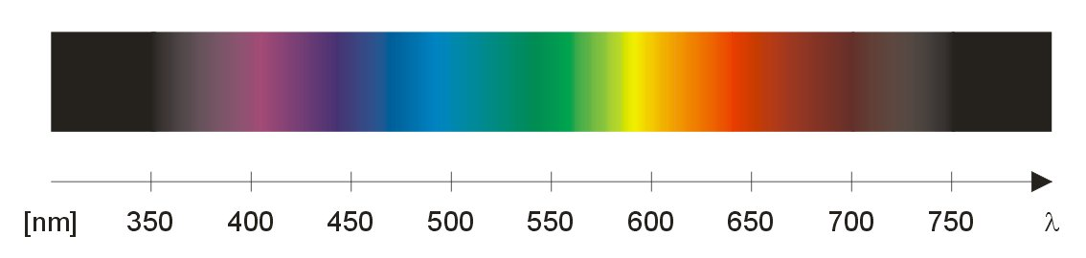
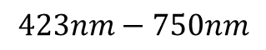
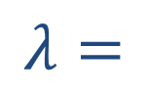
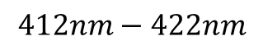
Design Analysis
Overview
MedLi_{Tx}
Wavelength Selection
Treatment Area
Visible Light Spectrum
þ
Safe
Effective
Approved
þ
þ
$$λ=$$
$$412nm−422nm$$
$$423nm−750nm$$
Blue Light Therapy
(primary design objective)
Used for other forms of PDT
(expanded design objective)
What wavelength light to use?
Most current PDT devices use one single light wavelength, while different treatments require different light at different wavelengths.
Our device incorporates multiple frequencies in a single device.

Slide 22

Design Analysis
Overview
MedLi_{Tx}
Wavelength Selection
Treatment Area
Light Filter Array
The design gives clinicians flexibility by incorporating light at various wavelengths in a single device for different treatments.
Light Source
Light Filter Array
Patient
White Light (380-750nm)
Violet light(380-450nm)
Red light(620-750nm)
Blue light(450-475nm)

Slide 23
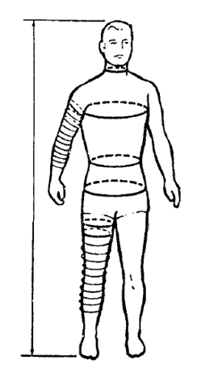
Design Analysis
Overview
MedLi_{Tx}
Wavelength Selection
Treatment Area
Fitting the Patient
Face
Theses are the physical areas
of focus established from consultations with PDT practitioners and literature research.
A flexible design is important
to be able to fit all the parts
of the body comfortably.
Chest
Back
Arms
Torso
Hands
Legs

Slide 24
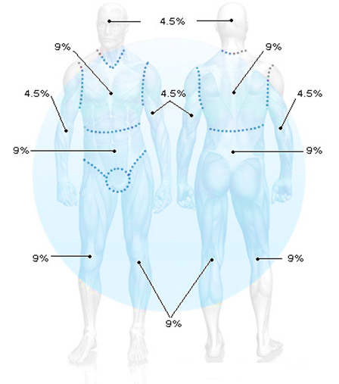
Design Analysis
Overview
MedLi_{Tx}
Wavelength Selection
Treatment Area
The Rule of 9
No more than 9% of the body should be treated by PDT at a time.
Head ≈ 9%
Chest ≈ 9%
Abdomen ≈ 9%
Upper/mid/low back and buttocks ≈ 18%
Each arm ≈ 9% (front ≈ 4.5%, back ≈ 4.5%)
Each leg ≈ 18% total (front ≈ 9%, back ≈ 9%)
$$\frac{\left[{Surface Area}_{MedLiTx}=.1m^{2}\right]}{\left[{Surface Area}_{avg}=1.73m^{2}\right]}=5.78\% =\% of avg adult treated by Med{Li}_{Tx}$$
Notes:
Our devices treatment area 5.78%

Slide 25
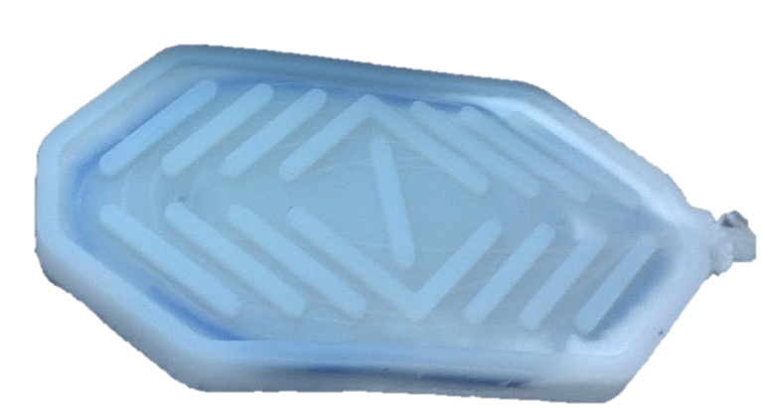
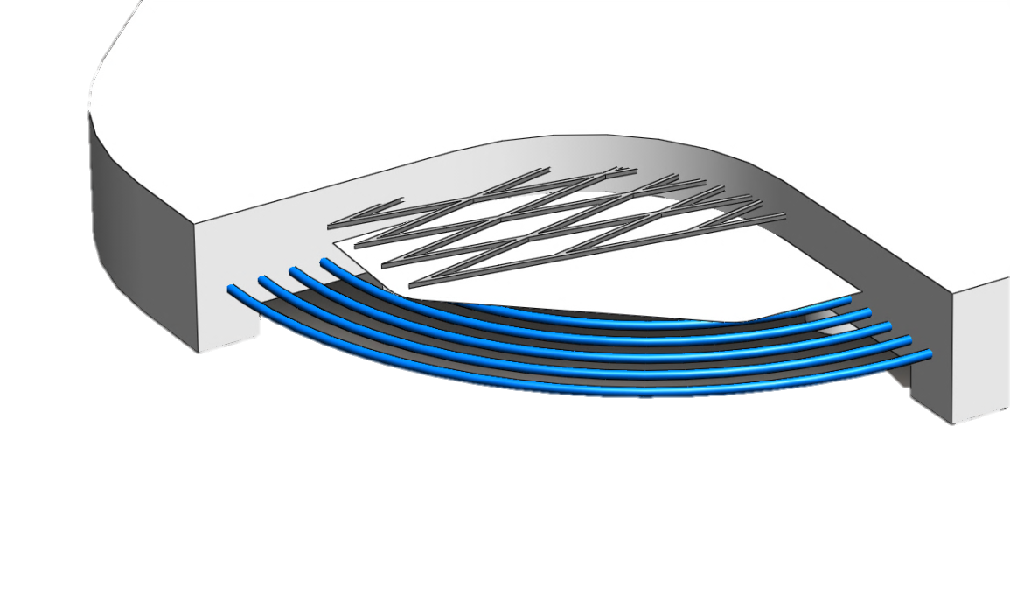
Design Features
Flexibility
Modularity
Light Weight
User Interface
Light Delivery Mat
þ
Flexible
þ
Inexpensive
Rubber Silicon
(Flexible, Biocompatible)
þ
Titanium Dioxide
(Light scattering agent)
Biocompatible
þ
Sterilize with Ease
Stainless Steel Mesh
(For ductility, malleability)
Reflective Metlar Sheet
(Reflects light forward)
Side-Glow Fiber Optic Cables
(Emits light throughout mat)
Notes:
Say what the team is commissioned with right away

Slide 26
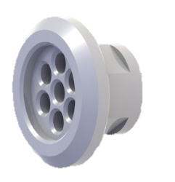
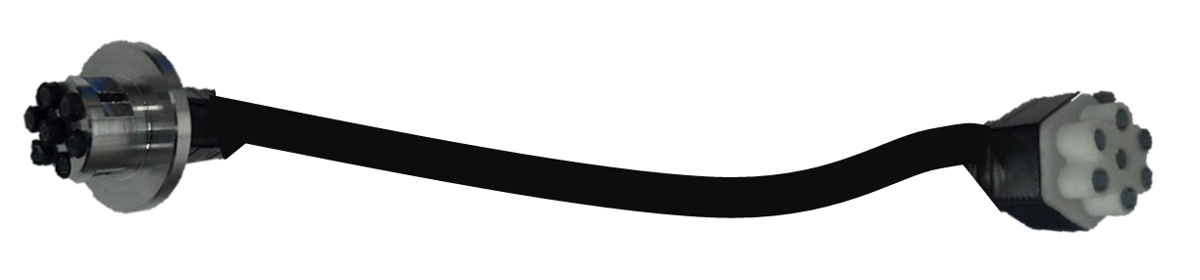
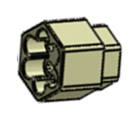
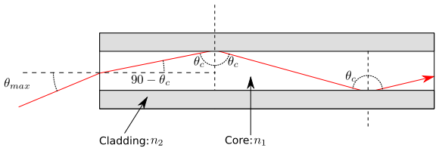

Design Features
Flexibility
Modularity
Light Weight
User Interface
Interchangeable Delivery System
We designed a fiber optic coupler that allows different delivery mechanisms to be plugged in, based on the specific treatment.
Physical Consideration
To mitigate losses when connecting fiber optic cables, the device is designed to use cables with the same numerical aperture.
$$NA=\sqrt{n_{1}^{2}−n_{2}^{2}}$$

Slide 27





Design Features
Flexibility
Modularity
Light Weight
User Interface
NIOSH Lifting Limit Formula
Based on the design specifications the Recommended Weight Limit is:
$$RWL=LC ×HM×VM×DM×AM×FM×CM=10×7.2×1.11×.87×.55×.95×1=$$
$$=$$
$$36.69 Lb$$
Height ≈ 72 in
Load Constant ≈ 10Lb
Coupling Multiplier= 1
Vertical Location ≈ 36 in
Asymmetry Angle ≈ 140$°$
Horizontal Multiplier=7.2
Frequency Multiplier=.95
Vertical Travel Distance ≈ 36 in
Distance Multiplier=.82+(1.8/36)=.87
Asymmetry Multiplier=1-.0032*140=.552
Vertical Multiplier= 1-(.003*[36-75])=1.117

Slide 28

Design Features
Flexibility
Modularity
Light Weight
User Interface
Existing User Interface:
?
What?
?
Huh?

Slide 29



Design Features
Flexibility
Modularity
Light Weight
User Interface

Slide 30
Design Features
Flexibility
Modularity
Light Weight
User Interface
Stop Treatment
Paused Treatment
Stop Treatment
Pause
Resume
Authorization Screen
Treatment Setup
Begin Treatment
Treatment Status
Approved
Denied
Change
Use Program
Saved Programs
Edit Parameter
Name Edit Screen
Save Program
Edit Program
New Program
Program
Edit
Save Parameter
Save Parameter
Save Parameter
Wavelength Edit Screen
Edit Parameter
Edit Parameter
Intensity Edit Screen
Time Edit Screen
Edit Parameter

Slide 31

Design Features
Flexibility
Modularity
Light Weight
User Interface

Slide 32

Design Features
Device Comparison
Design Goals
Flexibility | ✗ | ! | ✓
User Interface | ✗ | ✗ | ✓
Ergonomic | ✗ | ! | ✓
Cost | ! | ✗ | ✓
Patient Comfort | ✗ | ! | ✓
Breast Cancer Tx | ! | ✗ | ✓
Poor
!
✓
✗
Adequate
Excellent

Slide 33
Q&A
Thank you for listening.
Questions ?

Slide 34
Appendices
Design Criteria
IE Contributions
ME Contributions
Light Mechanism / Treatment Safety
User Interface Flowchart
Photodynamic Therapy Chemical Process
Responsibilities
Prototype Manufacturing Process
Prototype Costs
List of Terms(A-H)
List of Terms(I-Z)

Slide 35



Appendix
IE Contributions
Anthropometry & Ergonomics:
Manufacturing:
Usability:
Appendix

Slide 36




Appendix
ME Contributions
Device Design:
Flexible Fiber Optic Transmission Cable
Modular Cable Coupling
Material Selection:
Rubber Silicon
Titanium Dioxide
Stainless Steel Mesh
Light Source
Flexible Silicone Light Mat
Reflective Metlar Sheet
Appendix
Side-Glow Fiber Optic Cables

Slide 37





Appendix
Light Mechanism/ Treatment Safety
þ
Safe
Effective
Approved
Treatment of
Dermatological
Conditions
þ
Photosensitizing Agent (PSA)
Light Delivery
þ
Visible Light Spectrum
$$λ=$$
$$412nm−418nm$$
$$420nm−750nm$$
Appendix
Blue Light Therapy
(primary design objective)
Used for other forms of PDT
(expanded design objective)

Slide 38
Appendix
User Interface Flowchart
Stop Treatment
Paused Treatment
Stop Treatment
Pause
Resume
Authorization Screen
Treatment Setup
Begin Treatment
Treatment Status
Approved
Denied
Change
Use Program
Saved Programs
Edit Parameter
Name Edit Screen
Save Program
Edit Program
New Program
Program
Edit
Save Parameter
Save Parameter
Save Parameter
Wavelength Edit Screen
Edit Parameter
Edit Parameter
Intensity Edit Screen
Time Edit Screen
Edit Parameter
Appendix

Slide 39
Appendix
Design Criteria
Optimal patient comfort
Ease of use for clinicians
Inexpensive cost to broaden accessibility
Flexible design for various treatment applications
Appendix

Slide 40
Appendix
Photodynamic Therapy Chemical Process
Photodynamic Therapy
PDT is a form of light-activated treatment, which works in conjunction with a photo-sensitizing agent (PSA) to target and destroy unhealthy or dangerous cells.
Activated Pharmaceutical
O₂
Oxidizing Species
(Singlet Oxygen)
Oxidative Injury to Cells
Photon
Pharmaceutical
Cellular Death
Appendix

Slide 41
Appendix
Responsibilities
Usability
Anthropometry
Ergonomics
Device Interface
Functionality
Material Selection
Cost Effectiveness
Patient Comfort
Modularity
Packaging
Flexible Optics
Adjustability
Appendix
Industrial Engineering
Mechanical Engineering

Slide 42

Appendix
Manufacturing Process
Appendix

Slide 43
Appendix
Prototype Costs
Parts | Unit Cost | QTY | Total Cost
2 mm Solid Core: Side Glow Fiber | $2.75/ft | 40 | $110
125 grams Titanium Dioxide | $4.30 | 1 | $4.30
2 mil Reflective Metlar | $2 | 1 | $2.00
Moldmax 27T Silicone 1 Gallon | $88.82 | 1 | $88.82
5mm Solid Core End glow Fiber | $3./ft | 70 | $210
150 Watt Metal Halide Illuminator w/8 color wheel | $400 | 1 | $400
Illuminator-End glow fiber Coupler | $60 | 1 | $0
End glow-Side glow fiber Coupler | $60 | 1 | $0
Silicone Mold | $180 | 1 | $0
 | Prototype Parts Cost: |  | $815.12
Additional Manufacturing Costs
Coupler Machining | $60/hr | 2 | $120
Mold Machining | $60/hr | 3 | $180
Silicone Molding | $60/hr | 3 | $60
Assembly | $60/hr | 3 | $60
 | Additional Mfg. Cost: |  | $420
 |  | Total Cost | $1,235
Appendix

Slide 44
Appendix
List of Terms (A-H)
Actinic Keratosis: An overgrowth of skin layers resulting from extended exposure to the sun
Analgesia: A deadening or absence of the sense of pain without loss of consciousness
Apoptosis: a type of cell death in which the cell uses specialized cellular machinery to kill itself
Biocompatible: Not harmful to living tissue
Cladding: A covering or coating on a structure or material
Claustrophobia: Extreme or irrational fear of confined places
Coagulation necrosis: A type of accidental cell death typically caused by ischemia or infarction. This is in contrast to apoptosis, which is a naturally occurring cause of cellular death. While apoptosis often provides beneficial effects to the organism, necrosis is almost always detrimental and can be fatal.
Collimator: A device for producing a parallel beam of rays or radiation
Dermatology: The branch of medicine concerned with the diagnosis and treatment of skin disorders
Dosiology: The study and determination of the doses in which medicines should be administered
Dosimetry: The accurate measurement of doses, especially of radiation
Drug-to-light interval: The period of time between when the drug is given and when the light is applied
Epithelial tissue: Epithelium; membranous tissue covering internal organs and other internal surfaces of the body
Facilitator: A device, tool, or person that helps to bring an outcome by providing indirect or unobtrusive assistance, guidance, or supervision
Hysteresis: The phenomenon in which the value of a physical property lags behind changes in the effect causing it
Appendix

Slide 45
Appendix
List of Terms (I-Z)
Illuminator: A device for producing, concentrating, or reflecting light
Intravenous: Existing within, or administered into, a vein or veins.
Irradiation: Exposure to radiant energy (heat, x-rays, etc.) for therapeutic or diagnostic purposes
Jaundice: A medical condition with yellowing of the skin or whites of the eyes, arising from excess of the pigment bilirubin and typically caused by an accumulation of bile pigment
Levulan: Topical medication manufactured by DUSA, to be used in conjunction with their blue light to treat acne
Metvixia: Topical medication often administered along with PDT to make skin more sensitive to light
Noninvasive: Not penetrating the body, as by incision or injection
Oncology: The study of Cancer. The branch of medical science dealing with tumors, including the origin, development, diagnosis, and treatment of malignant neoplasms
Palliative Nursing: form of medical care or treatment that concentrates on reducing the severity of diease symptoms, rather than striving to halt, delay or reverse progression of the disease itself or provide a cure
Pathology: The Science of the causes and effects of diseases, the typical behavior of a disease
Photosensitization: skin condition marked by heightened sensitivity to artificial and natural light
Photosensitizer: A light-absorbing substance that initiates a photochemical or photo-physical reaction in another substance (molecule), and is not consumed in the reaction
Photodynamic Therapy (PDT): A form of light-activated therapy that may use oral or topical photosensitizing agents (PSA)
Spectrometer: An instrument used for measuring wavelengths of light
Sub-dermally: beneath the skin
Topically: Locally; to a restricted area of the body
Zimmer: the air hose used in light therapy to minimize burning sensation caused by light using cold air
Appendix

